Slide 1
Restaurant location analysis in Espoo (FI)
Anton Aro

Slide 2
Setting up a dining business
Location of restaurant is one of the keys to succeed in food industry
Thus analysing locations from demographic perspective is highly prioritized prior to choosing the restaurant location
This project aims to recommend variety of potential restaurant locations to open a new restaurant in Espoo, Finland

Slide 3
Data acquistion
Geographic information was acquired from open data portal: avoindata.fi
Espoo demographic information was acquired from Statistics Finland portal as .csv-file: StatFI
Restaurant information was retrieved through Foursquare API
The data set contained all postcode areas of Espoo and 100+ demographic variables
Final data has17 features

Slide 4
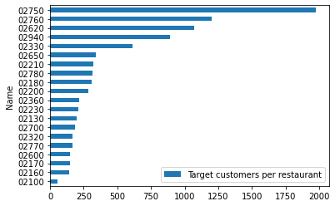
Restaurant offering per inhabitant varies
The targeted areas have notably large difference in terms of restaurants per inhabitants
Most restaurant dense areas have only 57 customers per restaunrant, while areas with higher opportunity provide up to nearly 2000 customer per restaurant

Slide 5
Benchmark area
Benchmark area was chosen through taking the most dense restaurant offering areas
Correlation analysis identified the most related demographic variable, which were then used to analyse area similarity and customer potential to to define the area recommendation for further analysis

Slide 6
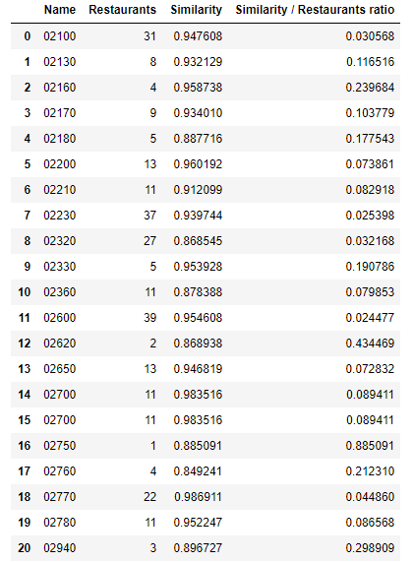
Top areas share important demographic characteristics
Eventhough the targeted areas are relatively similar in their demographics characteristics the number of restaurant varies quite extensively.
The recommended areas are based on the number of target population, relative similarity to top restaurant areas and number of restaurants in business in the area

Slide 7
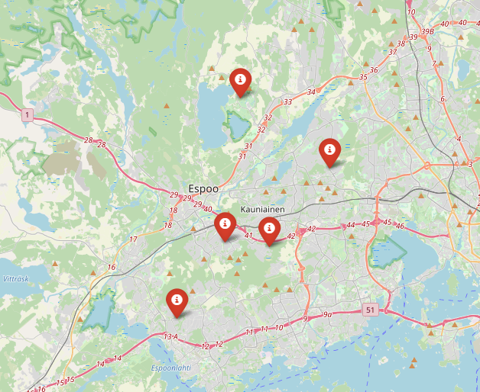
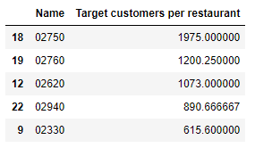
Recommended areas for further examination
Recommended areas for further examination were in different locations in Espoo sharing characteristics with the benchmark area
Further analysis could also include traffic analysis and tourist attractions

